Slide 1
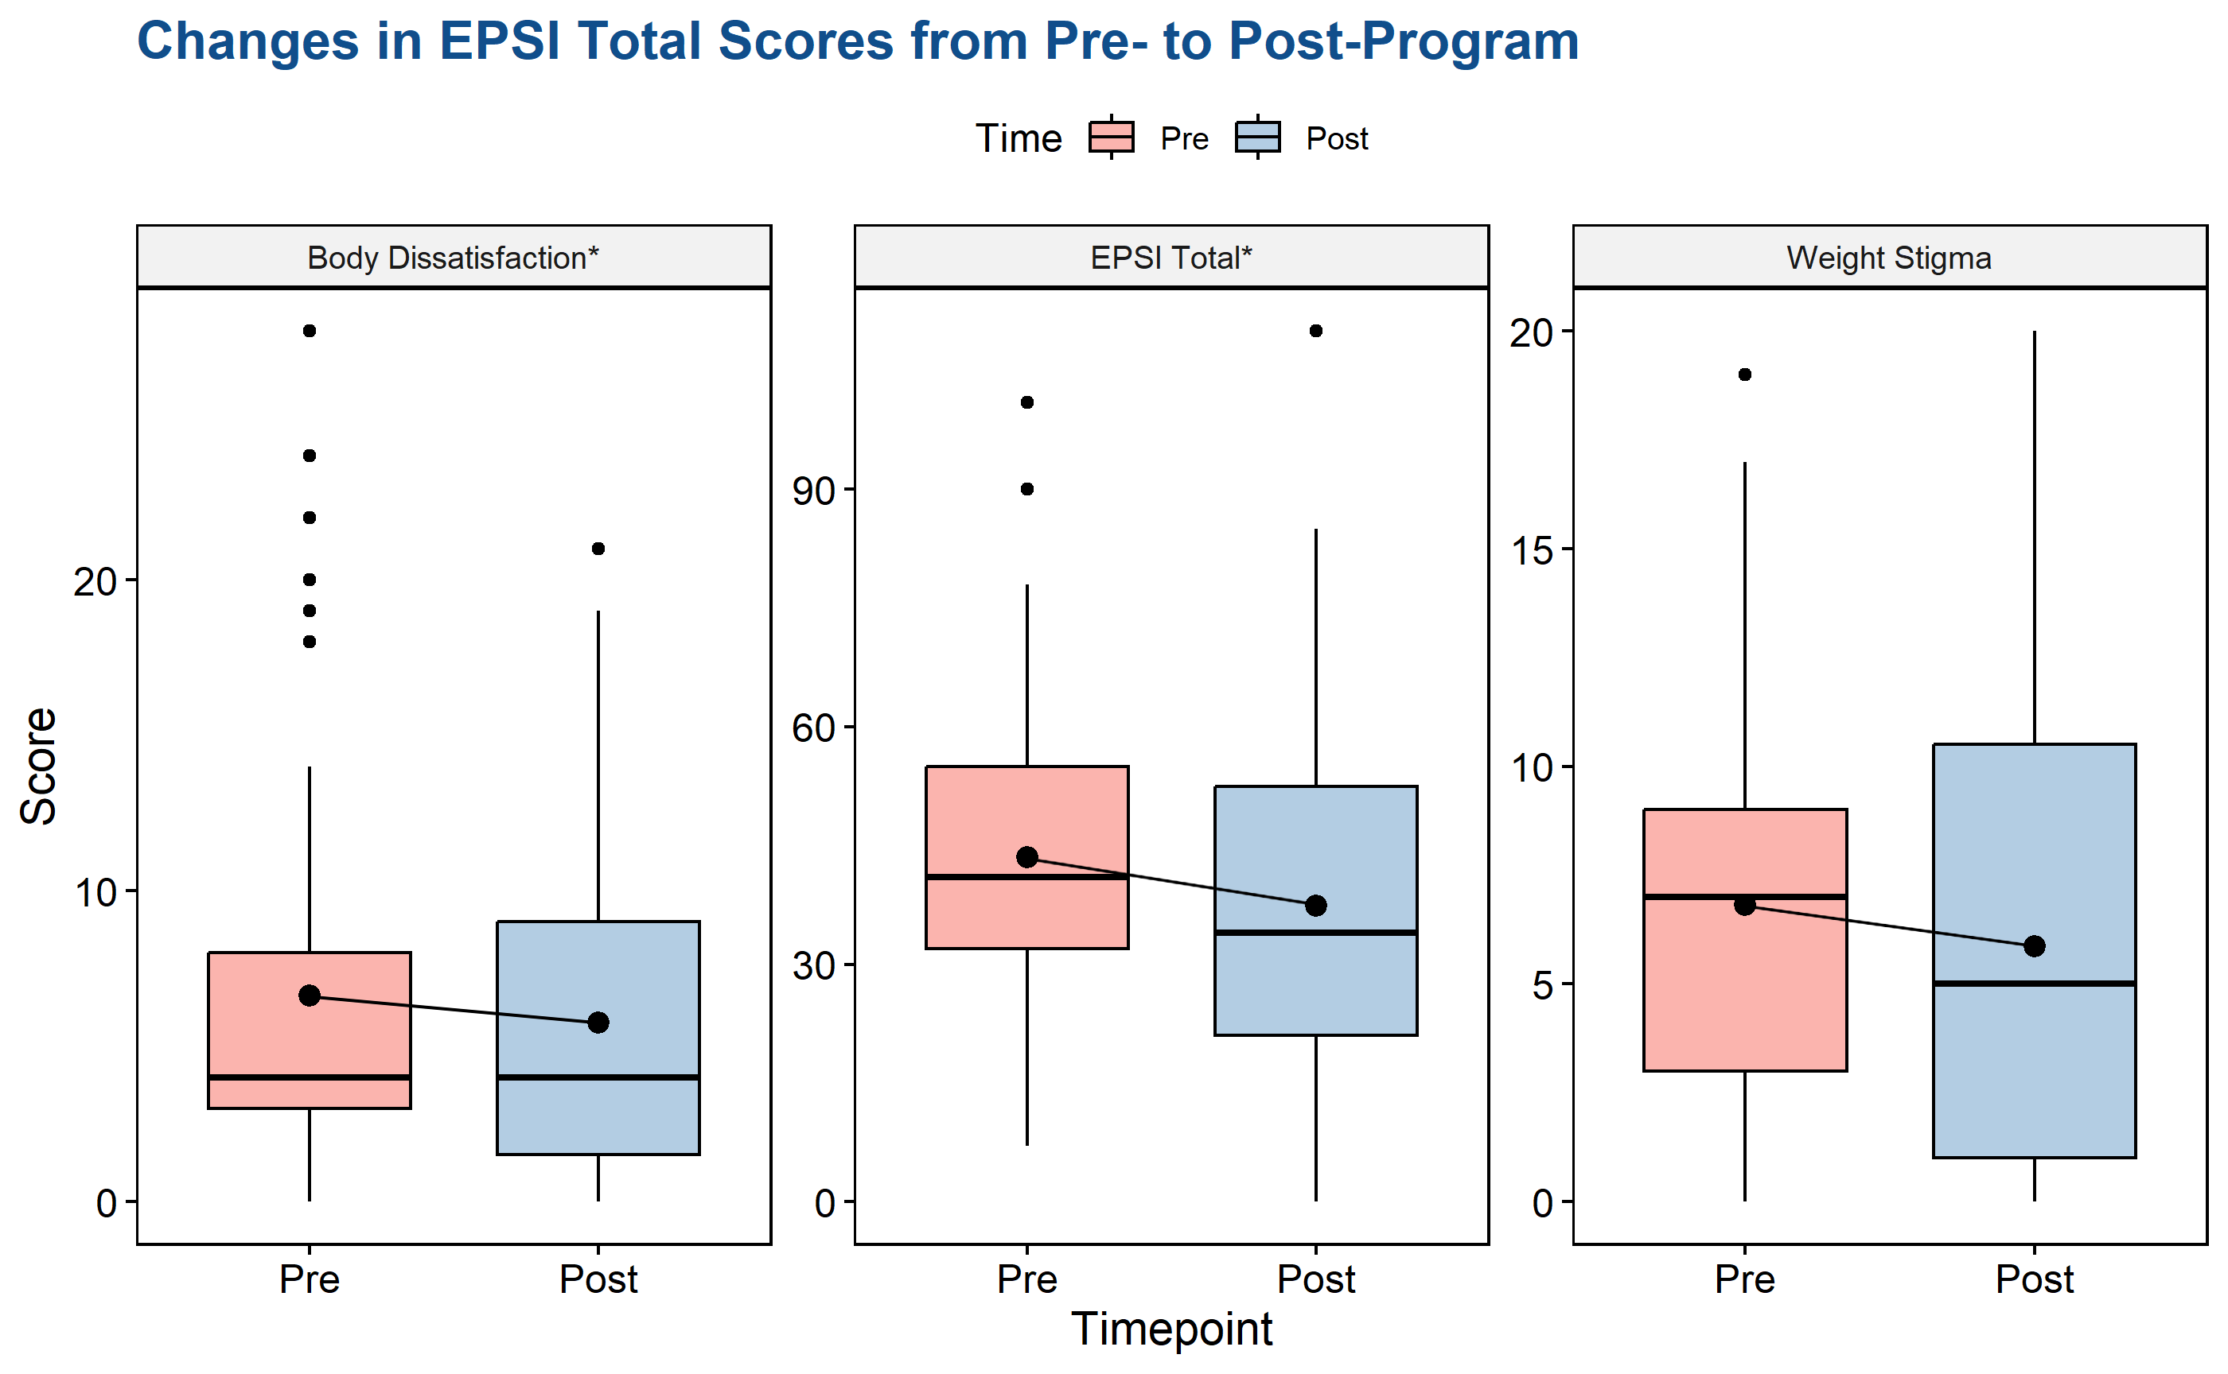



A dissonance-based eating disorder prevention program adapted for adolescent males may significantly decrease body dissatisfaction and eating disorder pathology.
Adapted Eating Disorder Prevention Program for Adolescent Males
Luis E. Sandoval-Araujo¹, Taylor Porter¹, Tiffany A. Brown², & Cheri A. Levinson¹
1, University of Louisville
2, Auburn University
RESULTS:
EPSI total scores significantly decreased (t[66] = 3.37, d = .29, p < .001) from pre- to post-program
Body dissatisfaction significantly decreased (V = 1123, p < .01, d = .14) from pre- to post-program
Weight stigma decreased, but the effect was not significant (t[66] = 1.53, p = .06, d = .18)
DISCUSSION:
Results show that the More than Muscles program, adapted for adolescent males, can decrease body dissatisfaction and eating pathology
  Effect sizes were lower than in the MTM program for adults
Results highlight importance of adapting prevention programs to the target population
  Smaller effect sizes may indicate additional improvement to the adaptation may be needed for adolescent males
Further research is needed to establish the effects of the MTM program compared to controls
The MTM program for younger males needs further testing in a wider array of audiences, settings, and in more diverse populations
  Program was disseminated in private schools
  Sample was majority white
BACKGROUND:
Eating disorder (ED) research focuses primarily on women and girls (Brown et al., 2023)
Prevalence of EDs in males is increasing over time (Smith et al., 2023)
Limited amount of prevention programs are designed for adolescent males
The Body Project, a dissonance-based prevention program, has shown promising reductions in ED symptoms (D’Adamo et al., 2023)
  Program has been adapted for men, called More than Muscles (MTM; Brown et al., 2017)
The present study aimed to pilot the efficacy of MTM in reducing ED symptoms in younger males
METHOD:
Sample consisted of 73 boys ages 12–15 (M = 13.13) from two private middle schools and one high school in the Southeastern United States
  86.3% White sample
Participants completed the MTM program
Eating disorder symptoms were measured using the weight stigma and body dissatisfaction subscale scores and total score of the Eating Pathology Symptom Inventory (EPSI)
Paired-sample tests were conducted to evaluate changes in subscale and total scores pre-program to post-program
  Effect sizes are reported for each analysis as Cohen’s d (small effect = .2)
* indicates statistically significant test
Citations, code, and other EAT Lab presentations available by scanning the QR code
Notes:
Notes:
In Powerpoint, click View > Guides
Keep text within gutter guides.
Author list: Don’t split names onto two lines (e.g., “Jimmy [break] Smith”). If that happens, use a new line, unless you need the space. Bold the first names of anybody who’s presenting in person.
Intro/methods/result: Do not drop below font size 28, but if you have extra space, jack up the font size until the space is full.
Do not use color in the sidebars except in graphs/figures. It’ll pull attention from the center and slow interpretation for passersby.

